Slide 1

Academic Session 2025-26
Even Semester Jan-July 2026
UNIVERSITY INSTITUTE OF ENGINEERING
DEPARTMENT OF AIT-CSE
Bachelor of Engineering (CSE)
AIML\Semester-4
STATISTICAL METHODS FOR AI
(24CST-295)
Unit No. 1 Chapter No. 1 Lecture No.1.1.1
Topic : Introduction to Statistics
Faculty Name and E_Code: Dr Neetu(E17077) Designation: Assistant Professor

Slide 2
Chapter | Course Objectives
1 | To enable students to develop a solid understanding of foundational statistical concepts and techniques relevant to artificial intelligence applications. To impart analytical ability in solving mathematical problems as applied to the respective branches of Engineering. To enable students to gain proficiency in applying statistical methodologies, including regression, classification, clustering, time series analysis, and experimental design, to analyze and model data in AI contexts. To prepare students for real-world AI projects and research endeavors by providing them with a solid foundation in statistical methods, enabling them to contribute effectively to the advancement of AI technologies.
Chapter | Course Outcomes
1 | Student will be able to Remember the foundational concepts of statistics, probability theory, regression methods, and estimation principles essential for AI and data-driven problem-solving.

Slide 3
Contents
Introduction to Statistics
Definitions of Statistics
Major Areas of Statistics
Descriptive Statistics
Inferential Statistics
Experimental Design

Slide 4
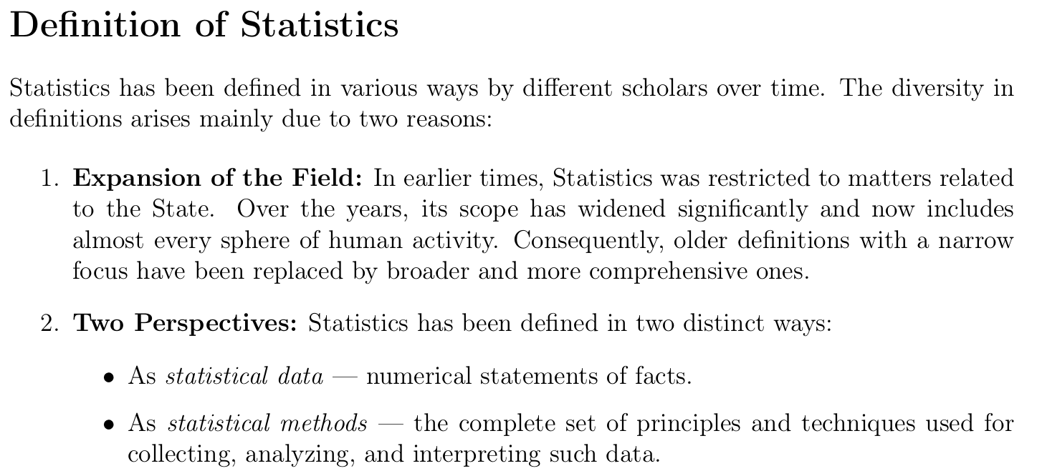
4

Slide 5
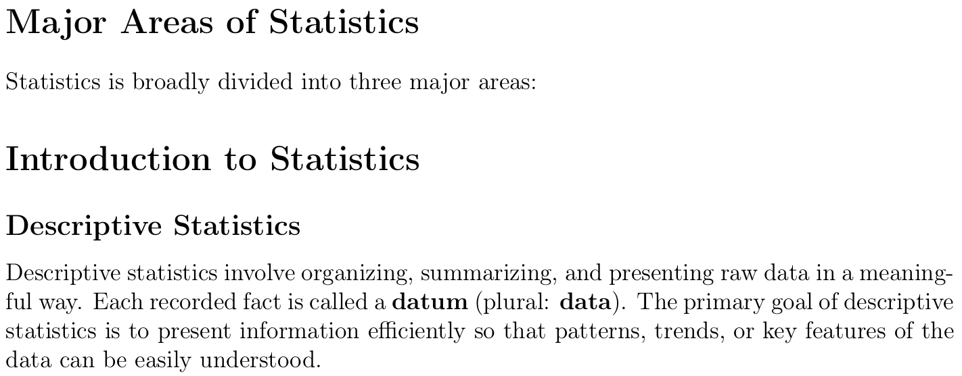

Slide 6
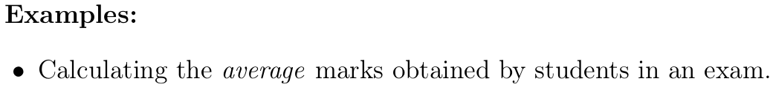
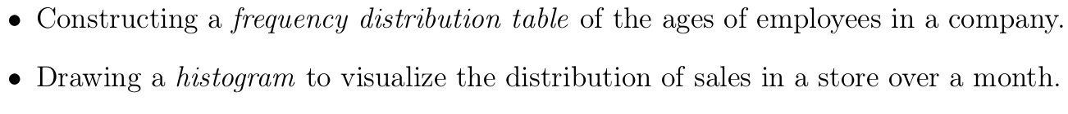
6
Notes:
Background source: PCA (1992).

Slide 7
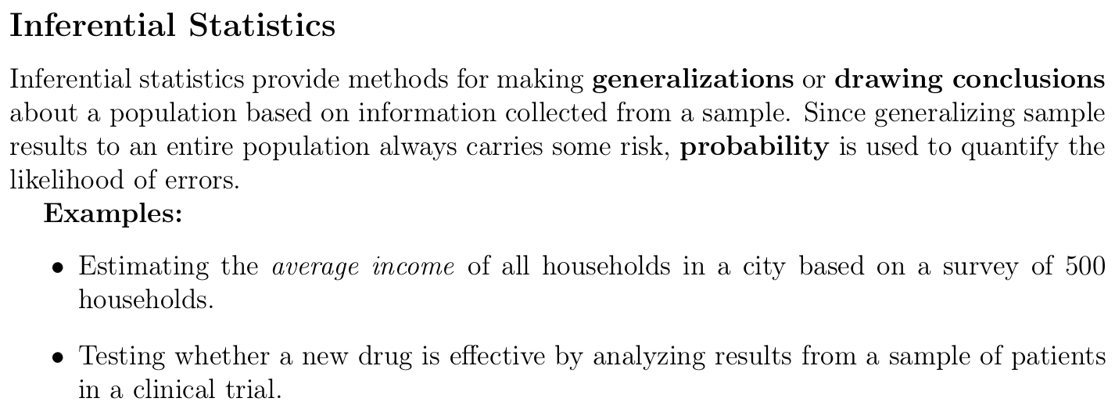

Slide 8
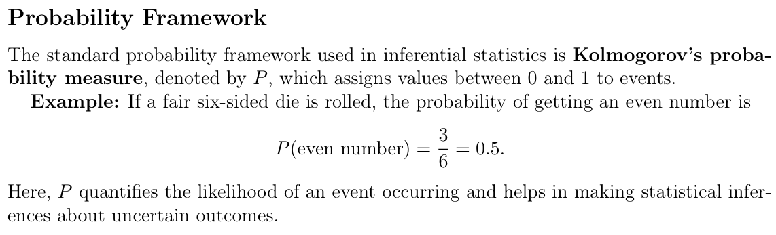

Slide 9
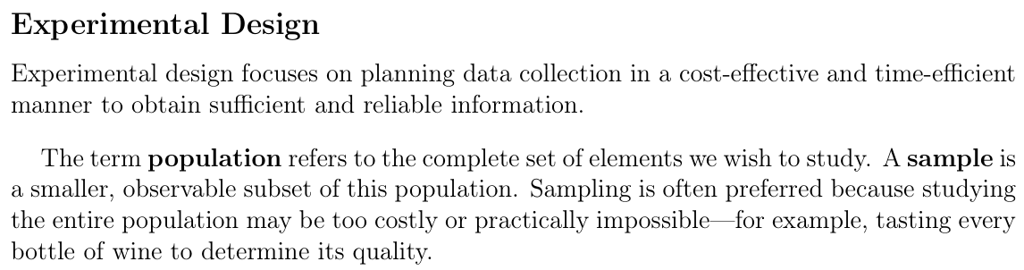
9

Slide 10
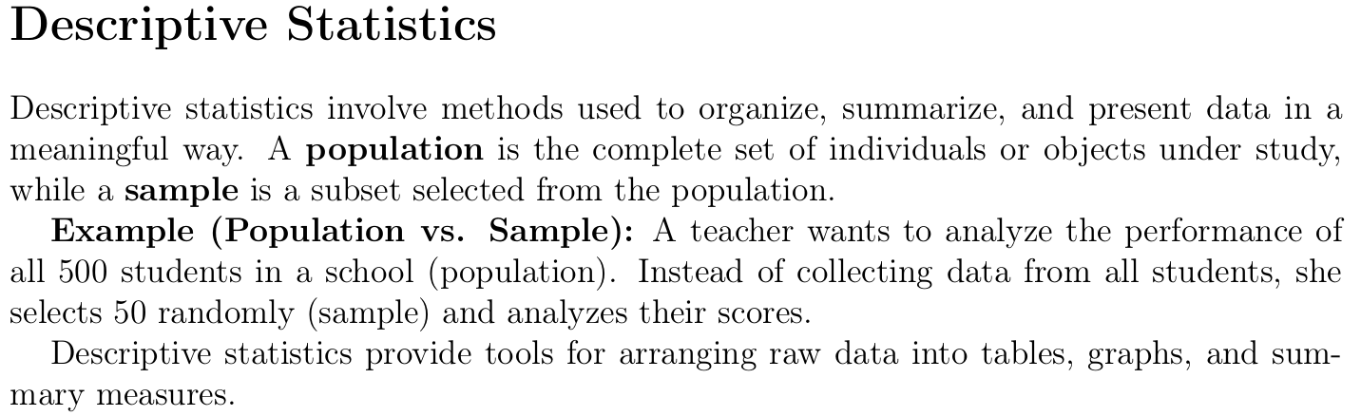

Slide 11
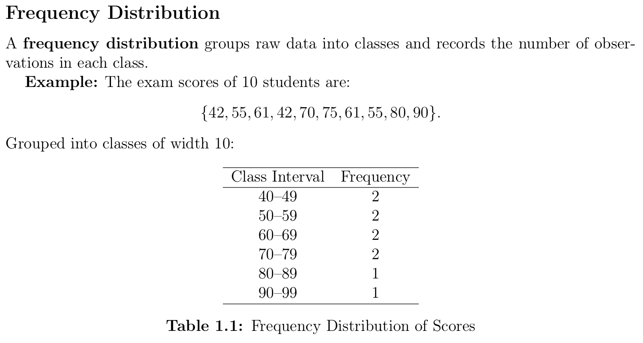
11
Notes:
Background source: PCA (1992).

Slide 12
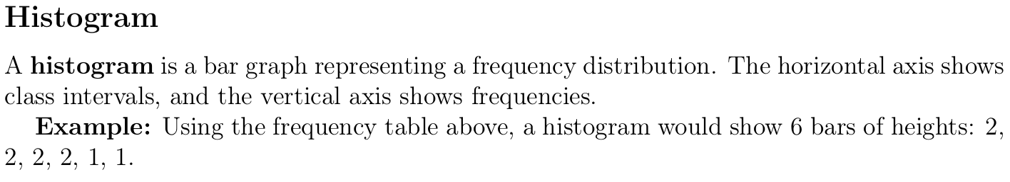
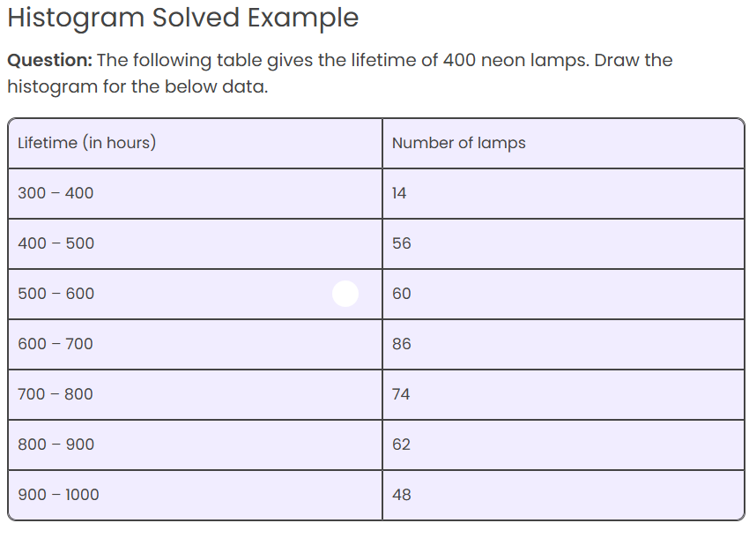

Slide 13
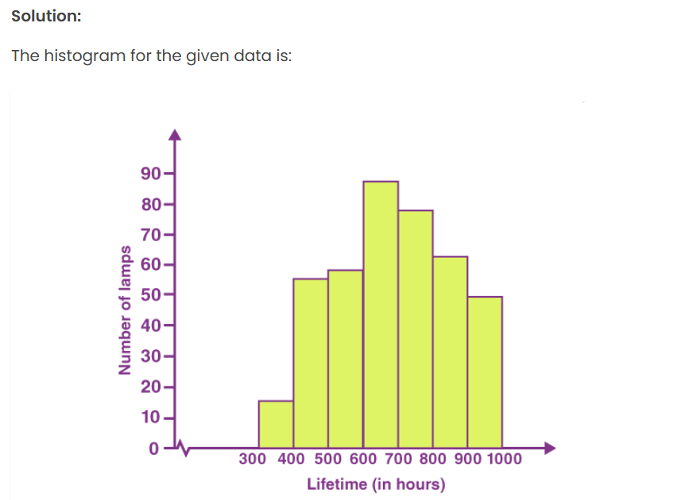

Slide 14
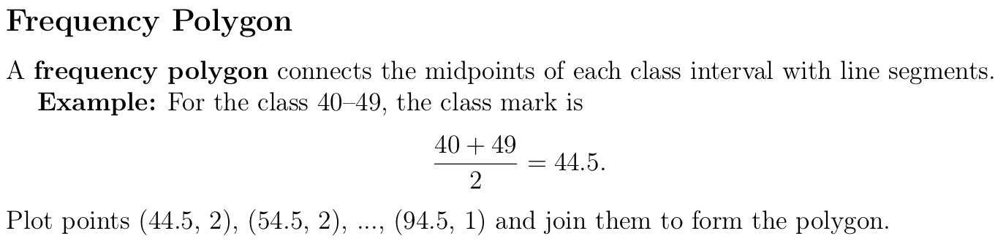
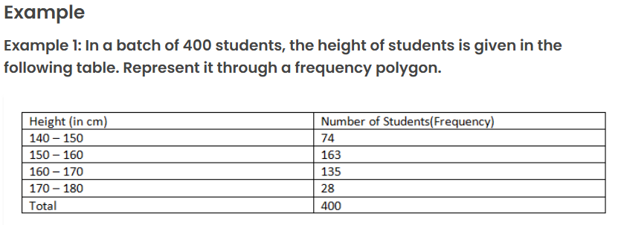

Slide 15
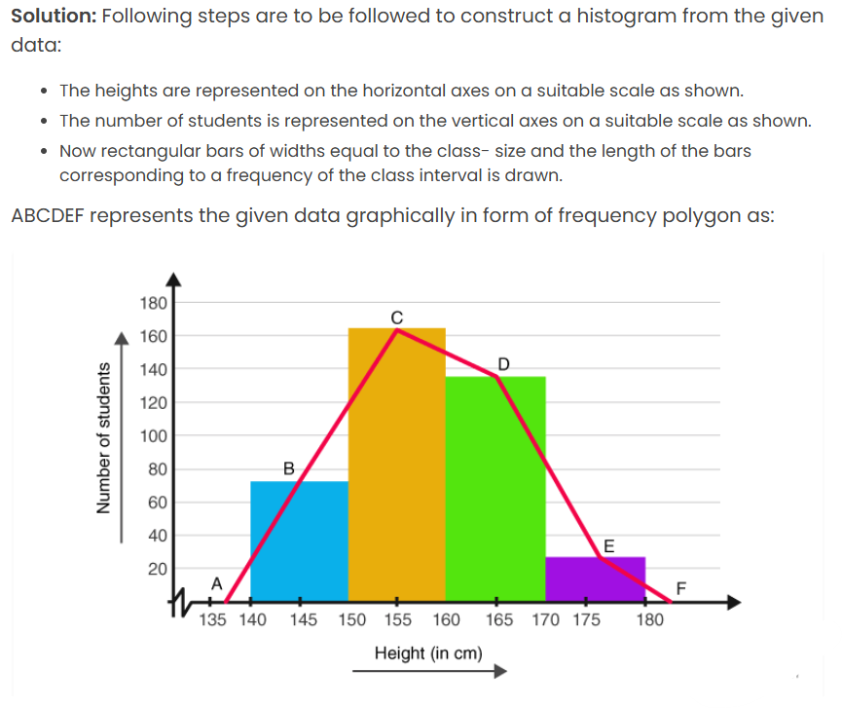

Slide 16
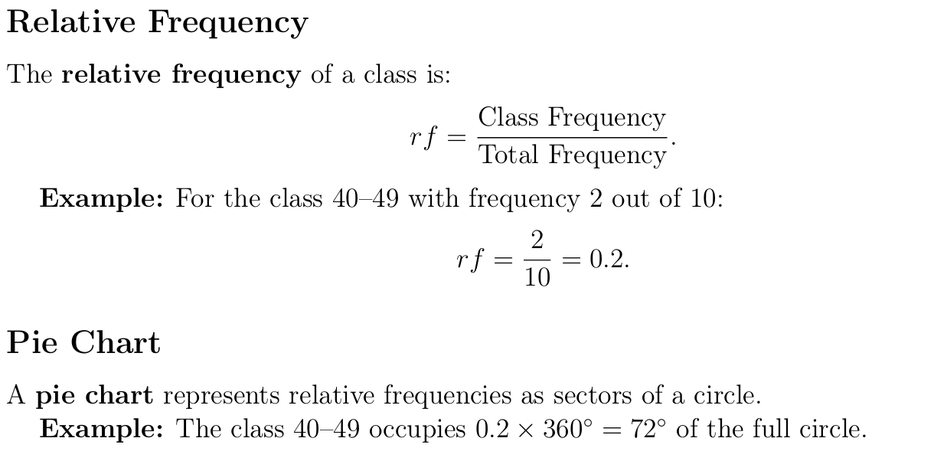

Slide 17
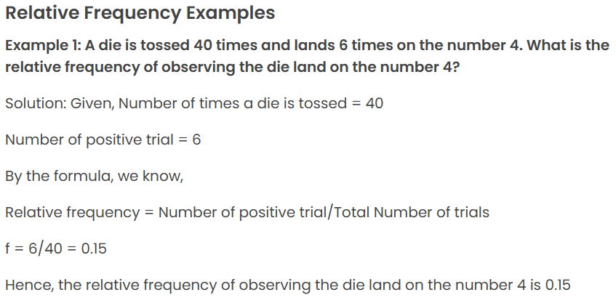
17

Slide 18
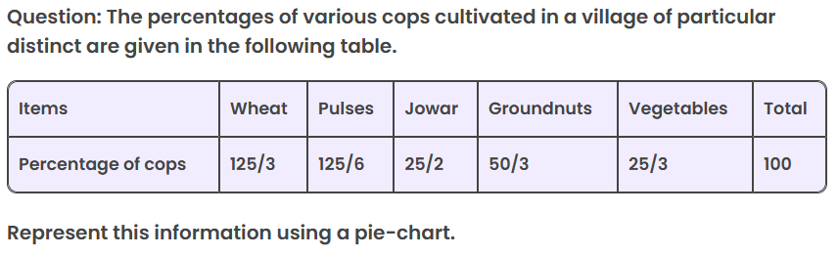
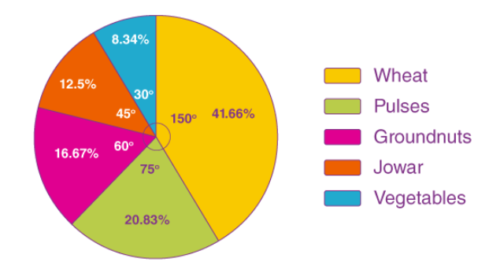

Slide 19
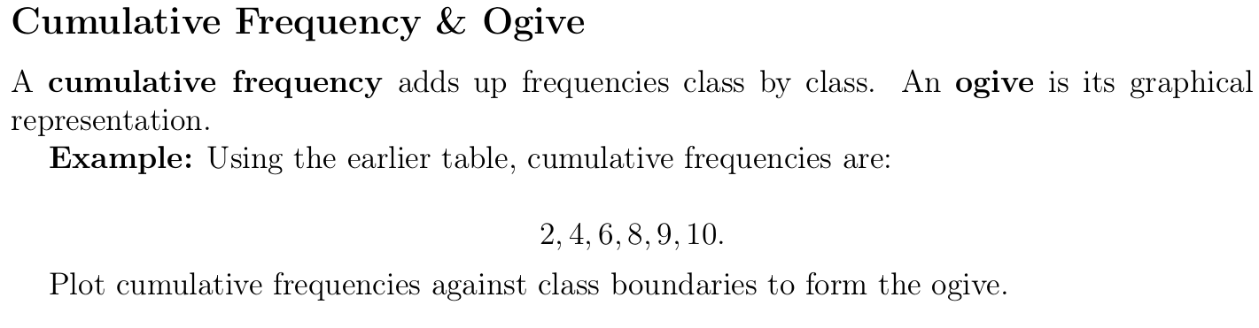
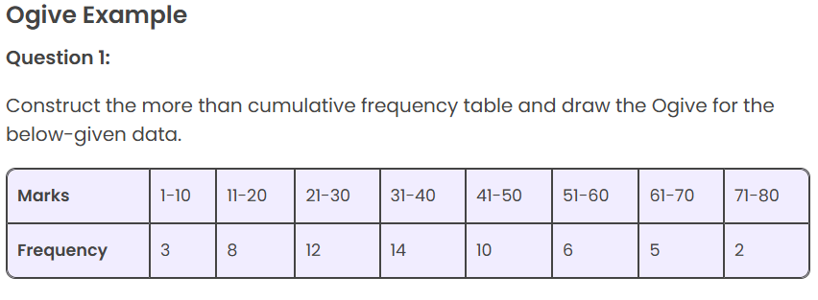
19
Notes:
Background source: PCA (1992).

Slide 20
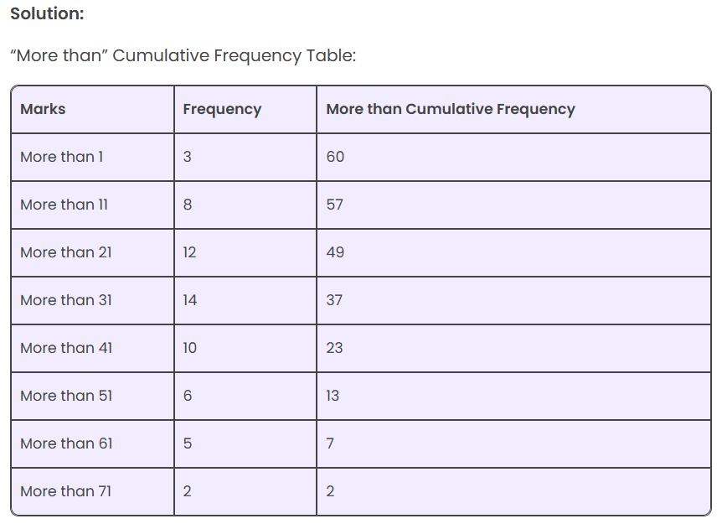

Slide 21
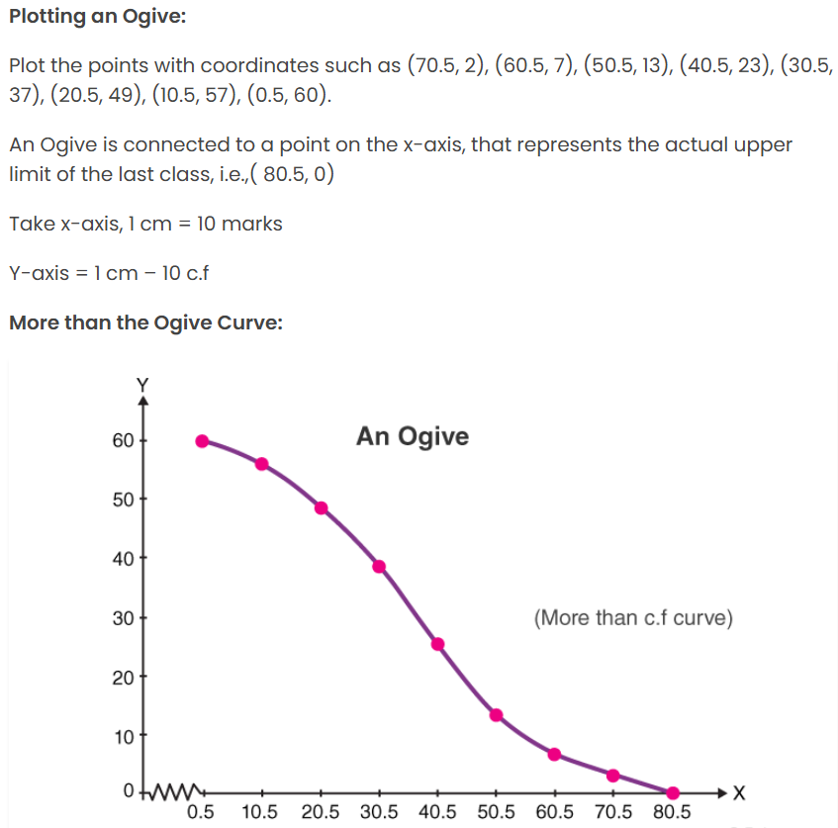

Slide 22
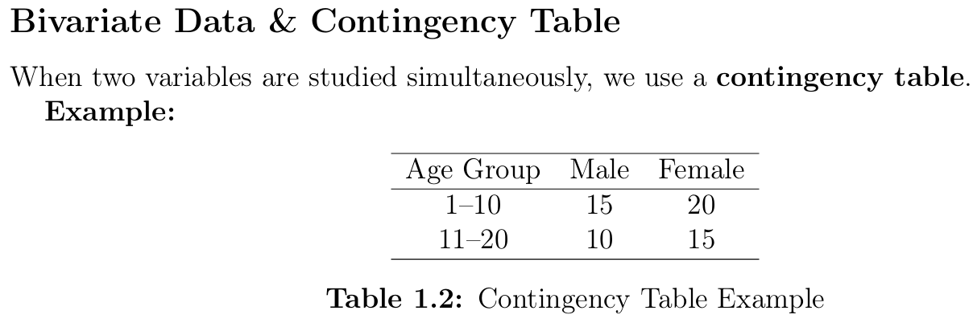

Slide 23
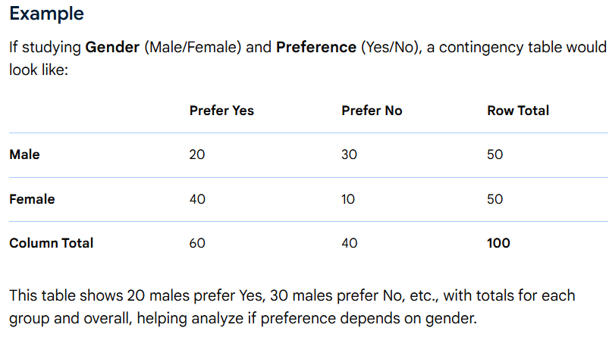

Slide 24
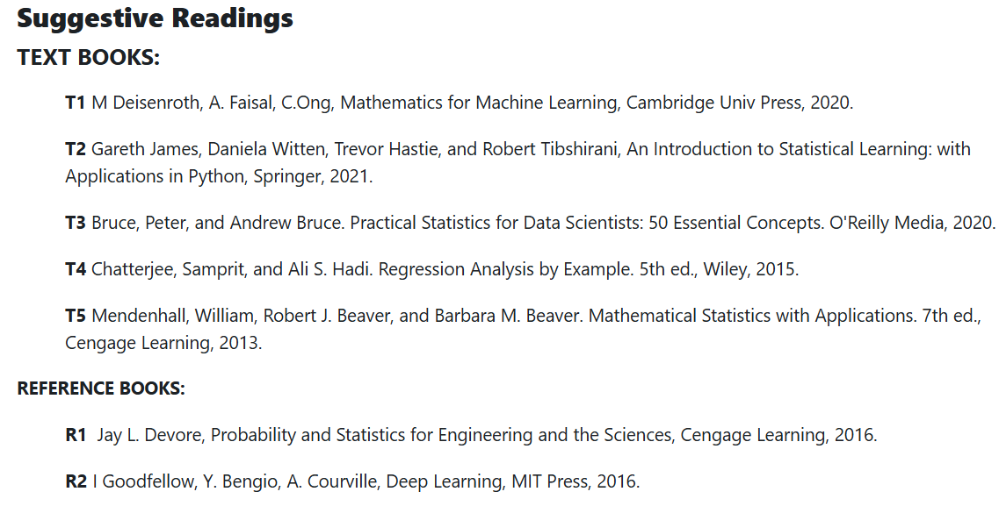
References
References
24

Slide 25
Online Video Link-
https://nptel.ac.in/courses/111/105/111105090/
https://www.youtube.com/watch?v=RYIb1u3C13I
https://www.youtube.com/watch?v=S_Zx-g8FU0w&list=PL6C92B335BD4238AB&index=18

Slide 26
THANK YOU
For queries
Email: neetu.e17077@cumail.in

